Slide 1

Fighting Exploitation with Convolutional Neural Networks
BY KYLE BLACK AUSTIN,TX
Notes:
Good Afternoon, My name is Kyle Black. I'm based out of Austin Texas and today I'm going to present: Fighting Explotation with Convoltional Neural Networks.

Slide 2
The following presentation contains discussion about sensitive subject matter. Discretion is advised.
Notes:
Just a warning. The following presentation contains a discussion about some sensitive subject matter. So I will advise discretion for the audience.

Slide 3
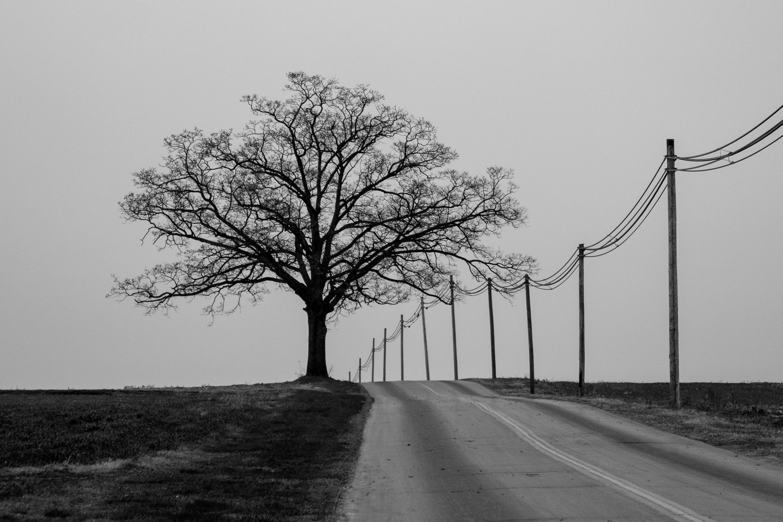
The Problem
Trafficking
CSEC
Human Trafficking is a modern day crisis, millions of people across the world are enslaved for labor, inscription and sexual abuse.
The commercial sexual exploitation of children (CSEC) is another term for what we often call child sex trafficking.
Advertisement
The Market
75% of CSEC survivors reported being advertised online. We pair that with the knowledge that more than 150,000 'escort' ads are posted online daily.
Trafficking is a $32 billion business world wide. Traffickers make $5,000 to $50,000 per person trafficked.
Notes:
The problem. Human trafficking is a crisis. While Human trafficking has been a tragic part of our existence for millenia.Yet many are oblivious to the illicit trade of human beings that takes place around the world that continues to this day, Including highly developed nations like the United States and Canada. MEn women and children are explotied for their labor, for their incsription and for sexual abuse. This project attempts to find a small sliver of solutions to the horrific problem of the commercial sexual explotation of children. Know as CSEC. Which I will refer to it as throughout this presentation. Unfortunately, there is an underground market for exploting vunerable children in such a matter and it factors into a world wide illcit trade of an estimated $32 billion market.

Slide 4

Pathway to Abuse
Underground Market
Lifelong Trauma
CSEC victims suffer from mental and drug problems.
Exploited children are traded.
Physical Abuse
CSEC victims suffer high rates of physical abuse.
Immigration Status
Traffickers use immigration status to take advantage
Cycle Repeats
Broken Homes
CSEC childhood is stolen by abusers.
Many CSEC victims come from broken homes or foster care
Sexual Abuse
Sold Online
Victims are subject to sexual abuse.
CSEC victims are solicited online.
Notes:
Before we get into the pathway of solutions for this problem I'd like to take a moment to explore how this abuse occurs. Abusers often groom children often from broken homes or the foster care system. Others take advantage of desperate children that are in limbo due to unstable immigration stauses and prey on desperation of families. Abusesers will take children and buy and sell them like a commidty. Here Children are put through tremndous abuse both physical and mental. Often times the next nstep is to solicit thenm online to to other abusers for a profit. This can happen often times around major sporting events such as the superbowl. The cycle repeats itself. Children often suffer from severe mental and drug abuse problems for the res of their lives.

Slide 5
Demographics of CSEC Victims
91%
African American & Latino Youth
50%
Child Welfare Involvement
50%
LBGTQ Youth
Notes:
Some of the more vulnerable demographics of children in the United States and Canada include African American and Latino children. Half of CSEC victims are involved in the child welfare system or foster care system. And half describe themselves as members of the LBGTQ community.

Slide 6


20%
OF ALL HOMELESS YOUTH IN THE US IN CANADA ARE CSEC VICTIMS
14%
OF ALL RUNAWAY YOUTH IN THE ARE CSEC VICTIMS
Notes:
1 in 5 of ALL homeless youth are victims of CSEC. 1 in 5! Runaway youth are also in significant danger as 1 in 7 of all runaway youth are victims of CSEC. Captors prey on the most vunerable children in our society.

Slide 7

The role of Technology.
The internet has made it easier for children to be bought and sold online. Law enforcement doesn't have enough resources to navigate online commercial sex market and identify their trackers.
Notes:
Technology plays a pivotal part in keeping the current CSEC system alive. The internet makes it easy for children to be bought and sold online, as well as solicited. Law enforcment does not have enough resources to scour the estimated daily 150,000 sexual solicitations online to find potential abuse victims.

Slide 8

75%
OF ALL CSEC VICTIMS REPORTED BEING ADVERTISED ONLINE
Notes:
3 in 4 victims of CSEC reported being advertised online. Which brings us how we can help fight this horrendous blight. Many abusers use the ambiguise surrondings of hotels to base operations and solicit abuse victims.

Slide 9

A FIGHTING CHANCE
Using Deep Learning to fight back against the pathway to abuse.
Notes:
The goal is to see if deep learning can help identify locations of abuse and give proper law enforcement and the National Center for missing and exploited children a fighting chance to catch abusers and provide evidence for their prosecution.

Slide 10
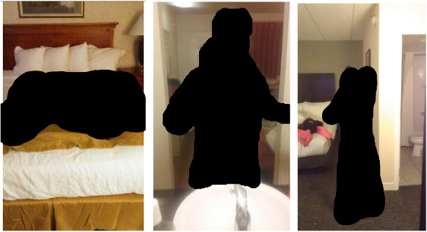
Many online CSEC solicitation ads use pictures taken hotel rooms.
Notes:
These photos, which are examples of CSEC solicitation ads, were provided by the exchange initiative, a project headed by the University of Washington in St Louis. Solicitation photos poses challenges due to low quality of images and uncommon camera angles.

Slide 11
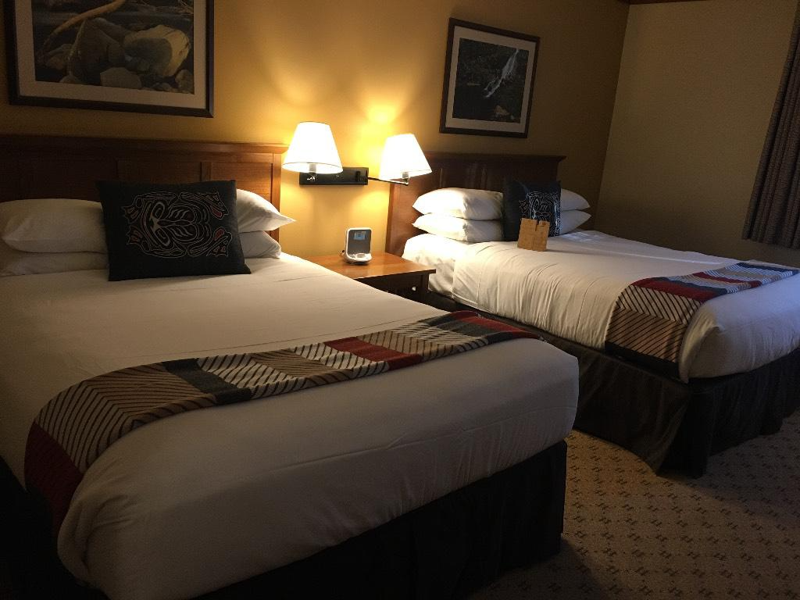
A database of photos.
Thanks to efforts led by the University of Washington in St. Louis a database of empty hotel pictures might hold a key to fighting this crisis. Contributors are asked to take pictures of their hotel rooms and those pictures are classified by hotel brand.
Notes:
The database of photos comes from a project called Traffik Cam, which encourages everyday app users to take photographs of the hotel rooms that they stay in. A typical entry takes at least two photo graphs, One of the bedrooms in the hotel and one of the bathroom. These hotels are separated according to a unique hotel ID number and a hotel chain number (indicating a specific hotel brand name). And I 'll get into more details about the data set in a moment.

Slide 12


Sequence of Events
Create a Database of Hotel brands
Data Munging
Build CNN
Train CNN
Prediction
Sort data by classes. Purge data that was insignificant.
By matching hotel brands to the vague class numbers, we can get a better idea of how hotel chains match and vary.
First I tried the VGG-16 archetecture. Next I tried a non-sequential network known as Efficient Net. I finally settled on the Xception network.
Training on AWS EC2 instance.
Predict on the top 5 hotel brands.
Notes:
So here are the sequence of events I've been working on. The first part was to wrangle the data and filter out some of the uncategorized data and very small-sized data classes. And classes for this I mean specfic hotel brands. Which i paired together with a list of the most popular hotel brands in the US to give the classification a little more clarity.

Slide 13
The Data

Slide 14
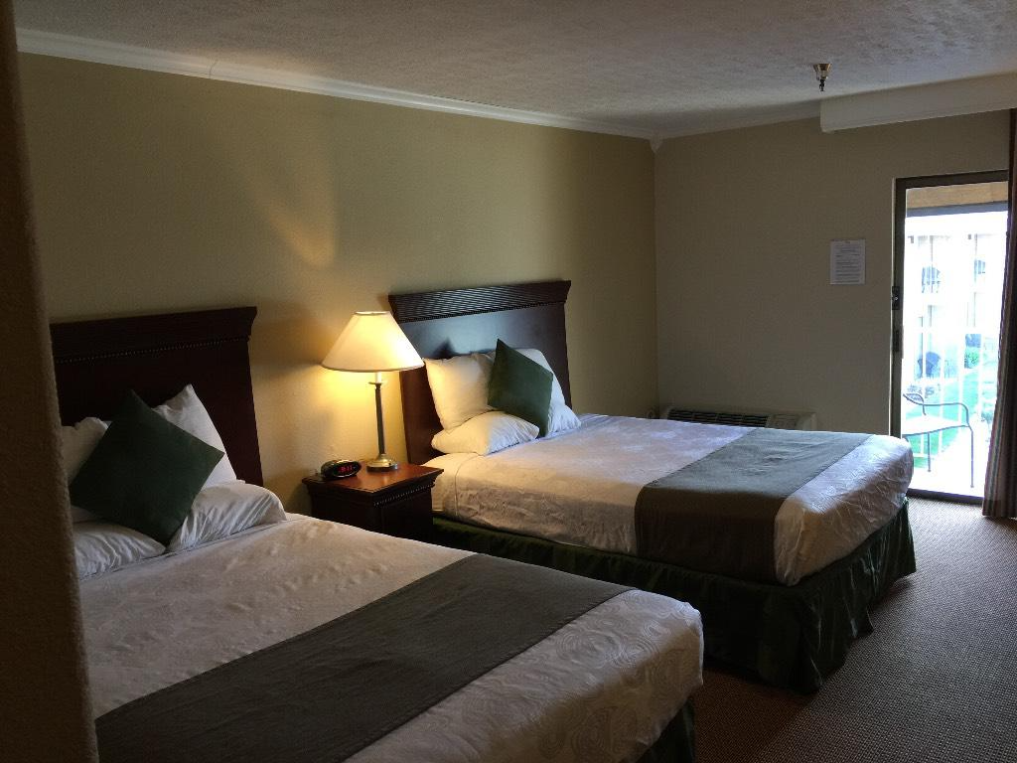


Challenging Data.
Data Set is large. 56 GB. Nearly 100,00 images.
Photos are taken from man a myriad of angles and lighting situations.
Hotels have high intraclass variation and low interclass variation.
Imbalanced Data Classes.
Notes:
The Data Sete that was put throught the net work is large close to 56 Gigabittes of photos of wildly varying dimensions. Nearly 100,000 images. Hotel rooms are an extrodinary difficult challenge in the ther is high intra class variation, and low interclass variation. (esentially meaning all hotel rooms kinda look the same, but hotels can wildy vary even among the smae hotel chain.)

Slide 15
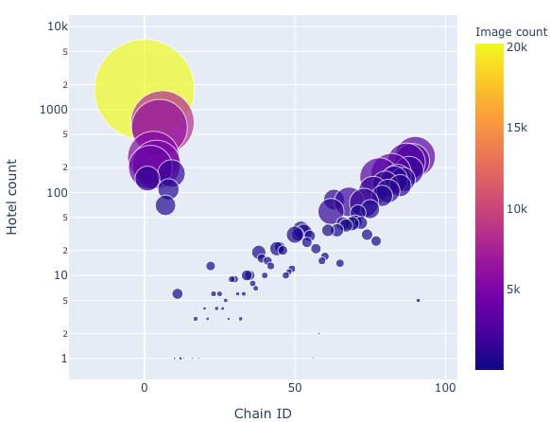
Imbalanced Classes.
Much of the data was unclassified by chain and many hotel chains had as few as one picture. My first step was to filter out classes with less than 100 examples and discard unclassified photos.
Notes:
AS you would expect the most popular hotel chains have the most images in the data set. The largest class seen here are uncategorized images that would be dropped for training the network.

Slide 16
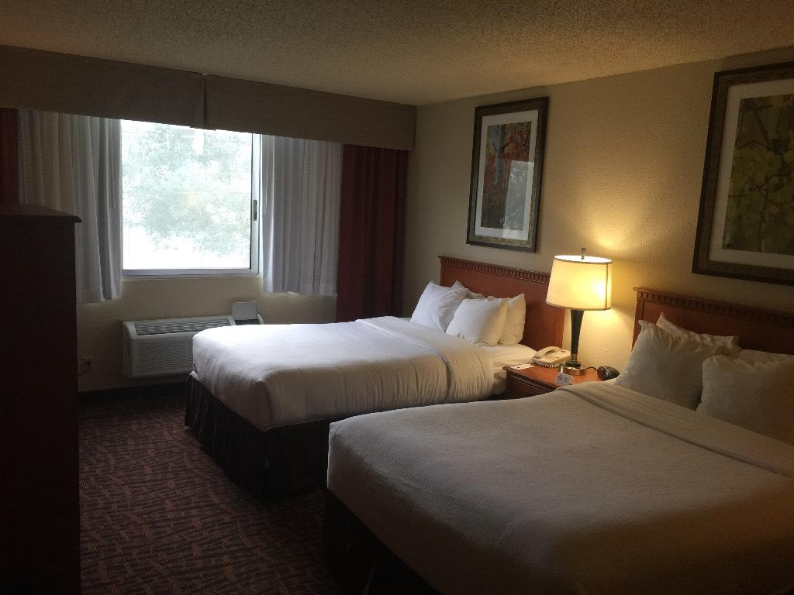
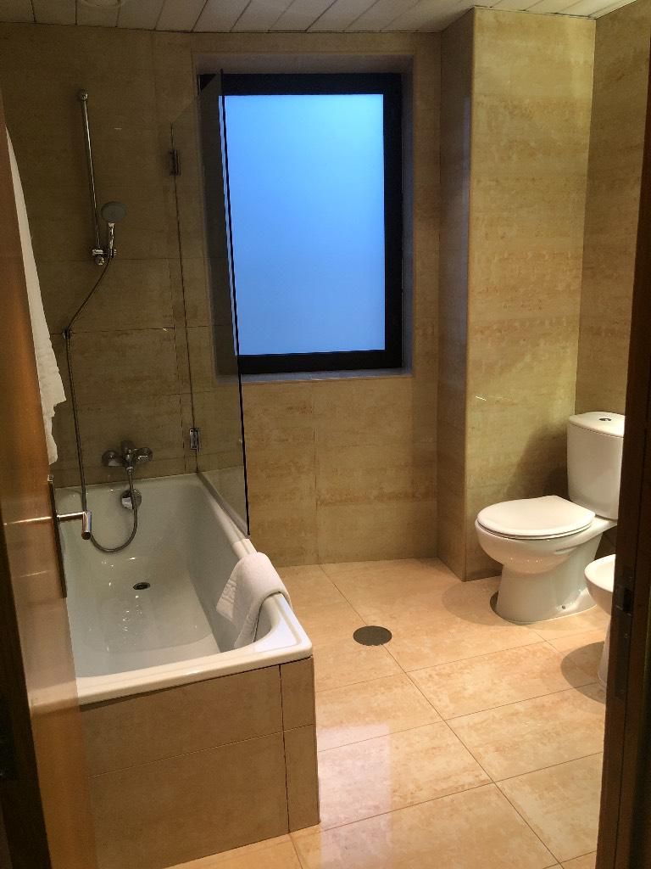
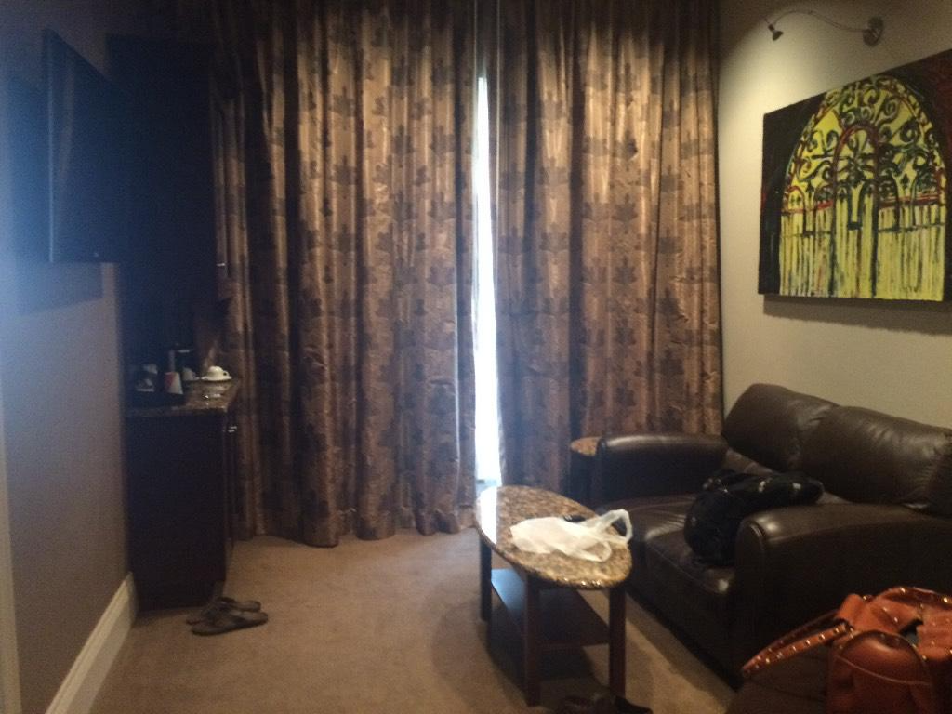
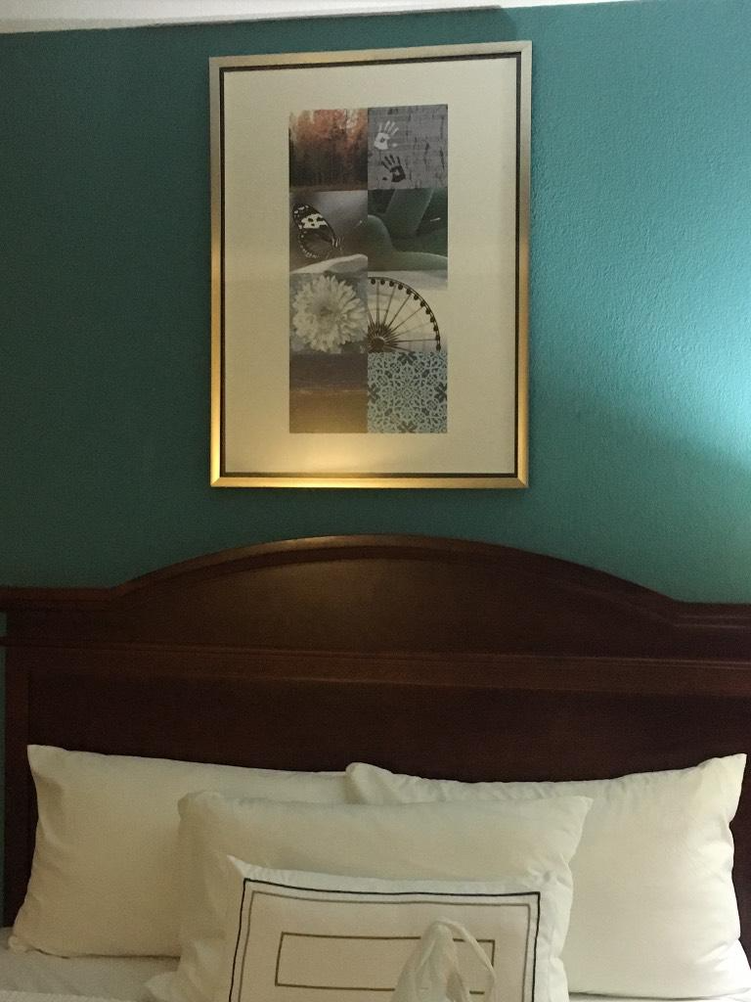
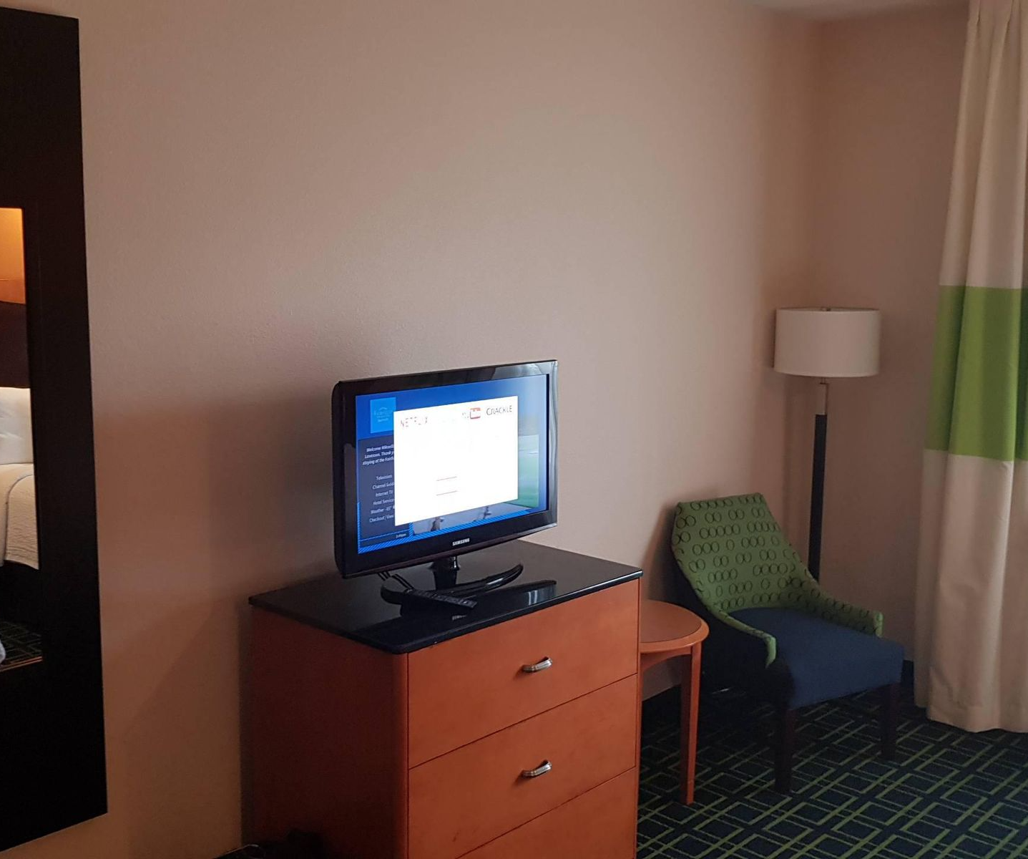
Notes:
Here is a random sample of hotel rom shots. as you can see, it's easy for humans to instantly recognize and classify objects like cats or dogs. But It's impossivle for us o differeintiate to show which brand is which.

Slide 17
Hotel Brand Database

Slide 18

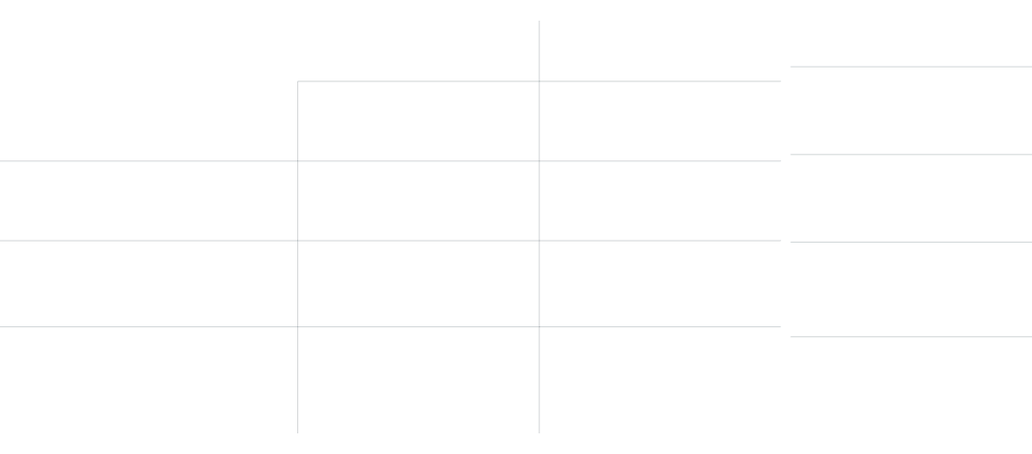
Data Table
Chain Brand
Index
Chain_ID
Hotel_ID
Fairfield Inn & Suites
0
1
24607
1
2
12306
Courtyard by Marriot
2
3
6261
Residence Inn
3
4
25583
SpringHill Suites
Notes:
This is what the database looked like. I ended up randomly adding a column of hotel chains to clarify more on the data.

Slide 19
CNN Archetecture

Slide 20
VGG-16
EfficientNetB0
Xception
Has a simple classical archetecture 2 convolutional layers and a pooling layer then 2 more convolutional layers and a pooling layer repeating until a 16 layers.
Network archetecture that uniformly scales all dimensions using a compound coefficient.

Slide 21
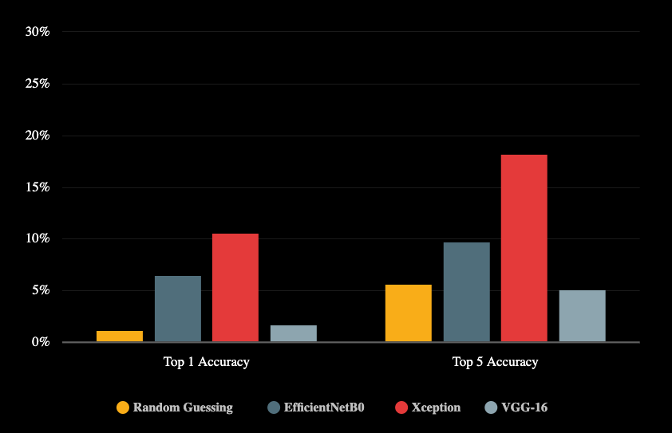
Validation Score Accuracy
Predicting on 88 Hotel Brands

Slide 22
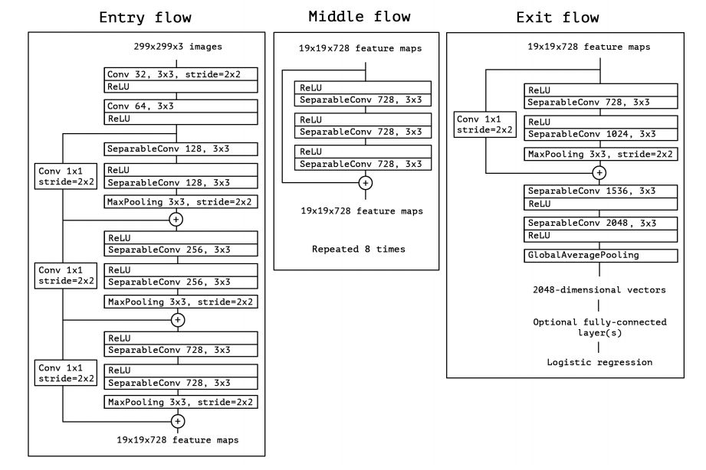
Xception
Has a separable convolution layer makes strong assumptions that spatial patterns and cross channel pattern can be modeled separately.

Slide 23




Narrowing the Scope
Input photo to investigate
Photo is uploaded to application
Model makes prediction about the photo based on training
Based on the Xception model.
Result
Model creates top predictions and connects to database of hotel chain.
Authorities can narrow scope of search
Authorities use this information to help with ongoing investigations. Specifically about where the crime is occurring.

Slide 24
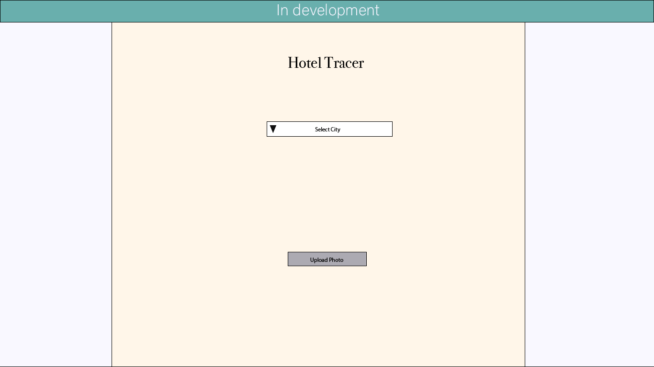

Slide 25
